Slide 1
LogiTest Presentation
Xinyue Yu

Slide 2
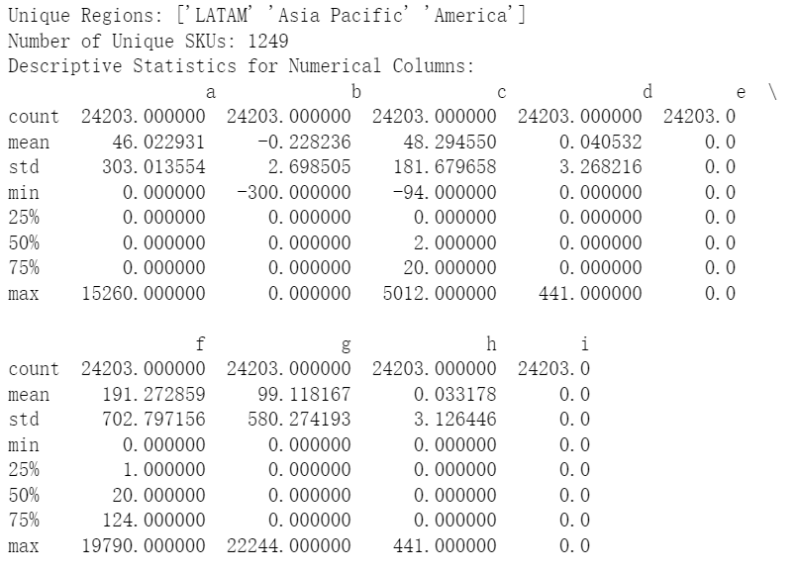
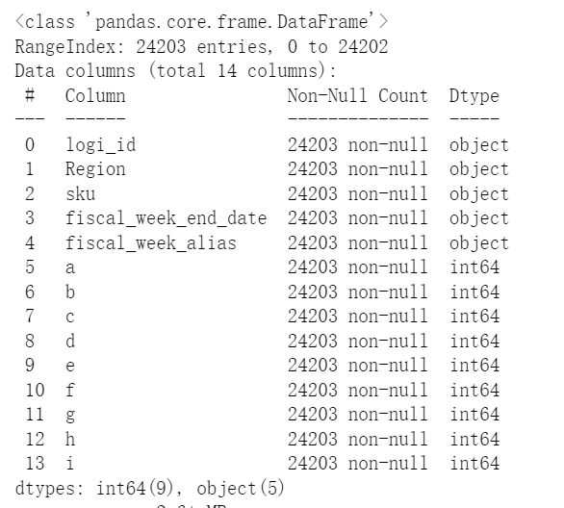
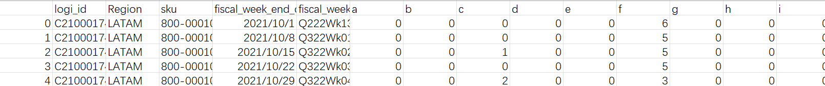
Part 1, Supply Chain Dataset: sc_data.csv
Type transformation

Slide 3
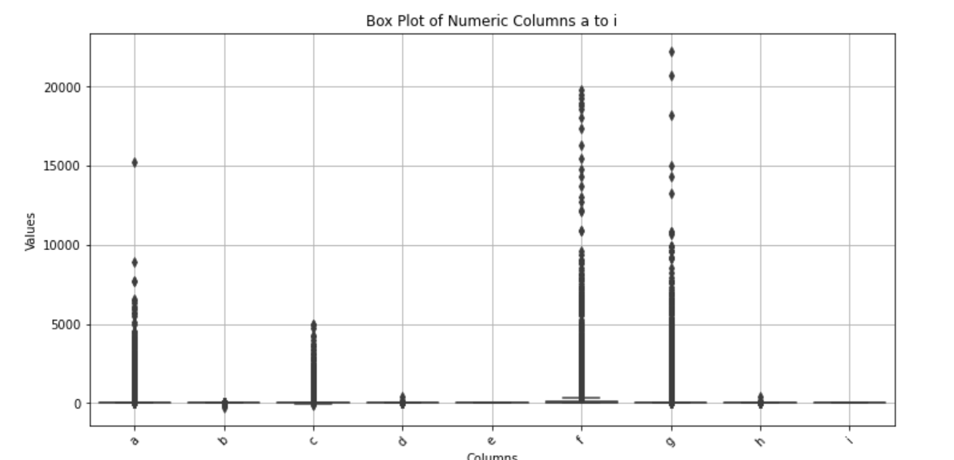

Slide 4


Part 2: Product Data Analysis
DataFrame
df_pl
df_dt
df_add
Product Line Data
Store Sales Data
Store Address Data
df_pl.csv
df_dt.csv
df_add.csv

Slide 5
1) Join Data Sets
Product Line Data
Store Sales Data
Product Line Desc
Parent Store Number
Monthly Sales Data
Product SKU
Check if all SKUs in df_dt are in df_pl and all SKUs in df_pl are in df_dt.

Slide 6
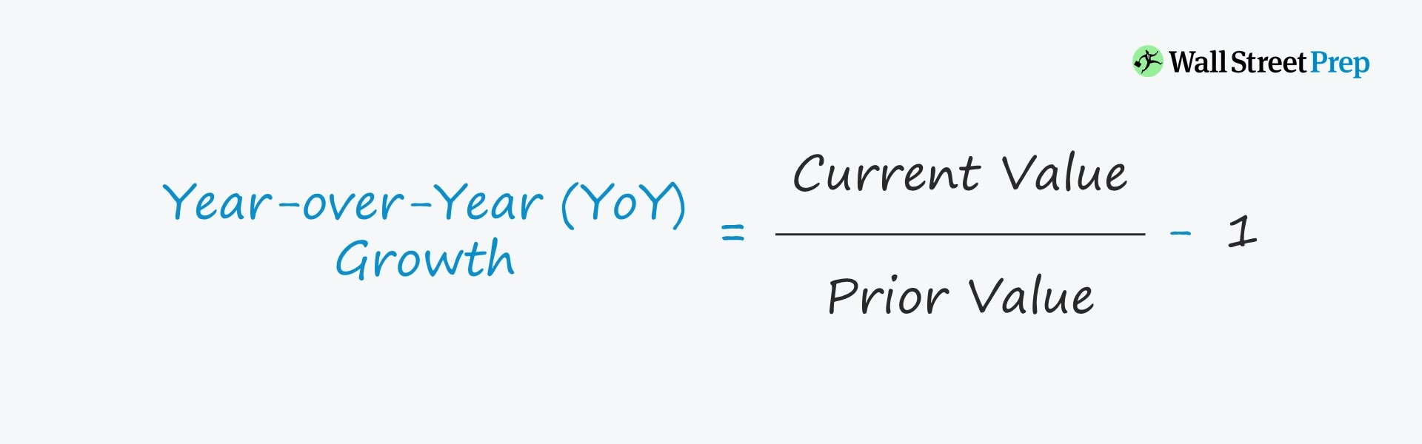
2) YoY growth by month of the product lines
YoY Growth rate=(Current Year Sales by month−Previous Year Sales by month)/
Previous Year Sales by month
calculate_yoy_growth(data)
To Visualize this trend:
Heatmap, Line Chart, Stacked Bar Chart.

Slide 7
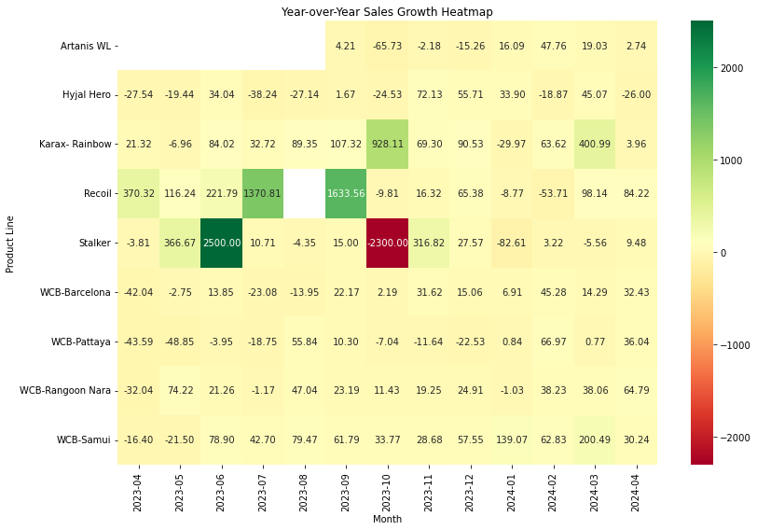
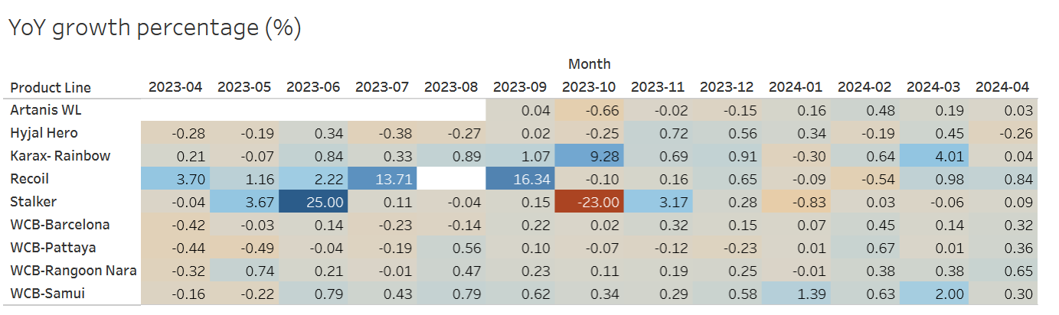
2) Product Line YoY Growth by month Visualization
Heatmap

Slide 8
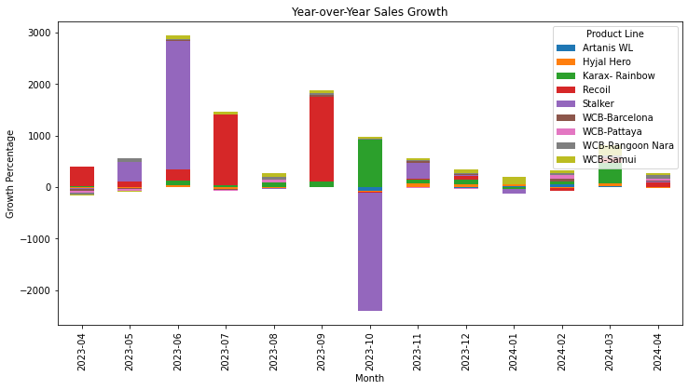
2) Product Line YoY Growth by month Visualization
Stacked Bar Chart

Slide 9
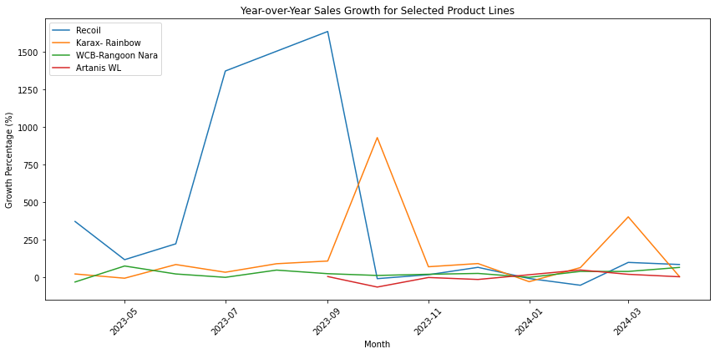
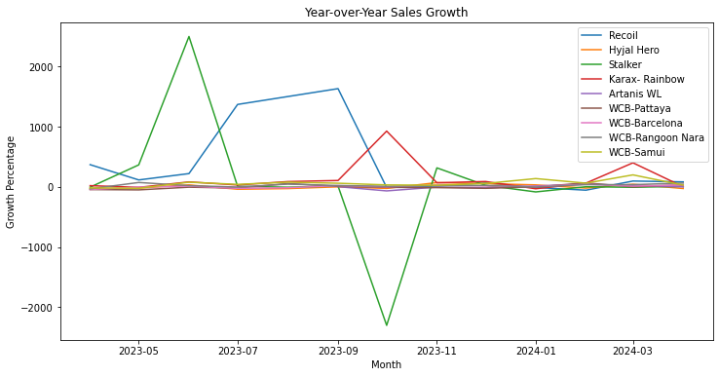
2) Product Line YoY Growth by month Visualization
Line Charts

Slide 10
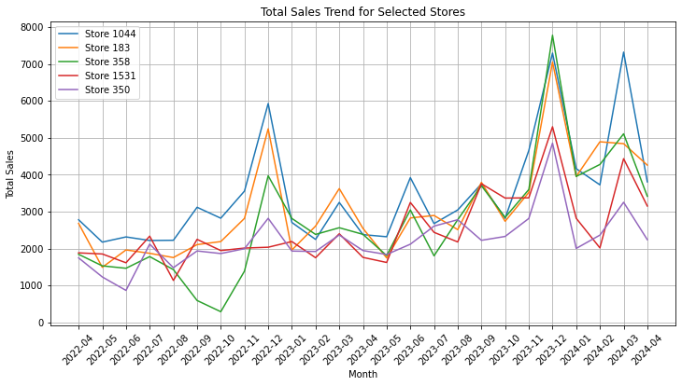
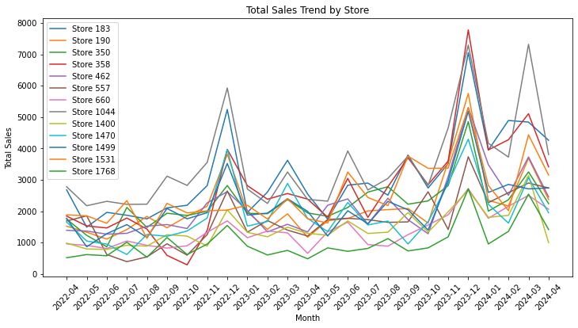
3) Total Sales Visualization
Line Charts
Notes:
For example, Store 1044 and Store 183 generally have higher sales compared to the other stores throughout the period.

Slide 11

3) Inferences From Data
Growth Trends:
Overall, relatively stable or slightly increasing.
Seasonality:
Peaks near end of year.
(Promotions, holidays…)
Variability:
Store-specific factors.
(Location, target market, or store-level strategies)

Slide 12
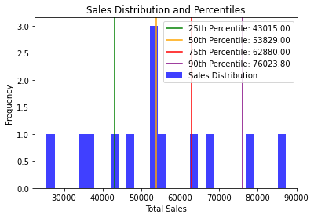
4) Tier Store Level Performance
25th Percentile: 43015.0
50th Percentile: 53829.0
75th Percentile: 62880.0
90th Percentile: 76023.8

Slide 13
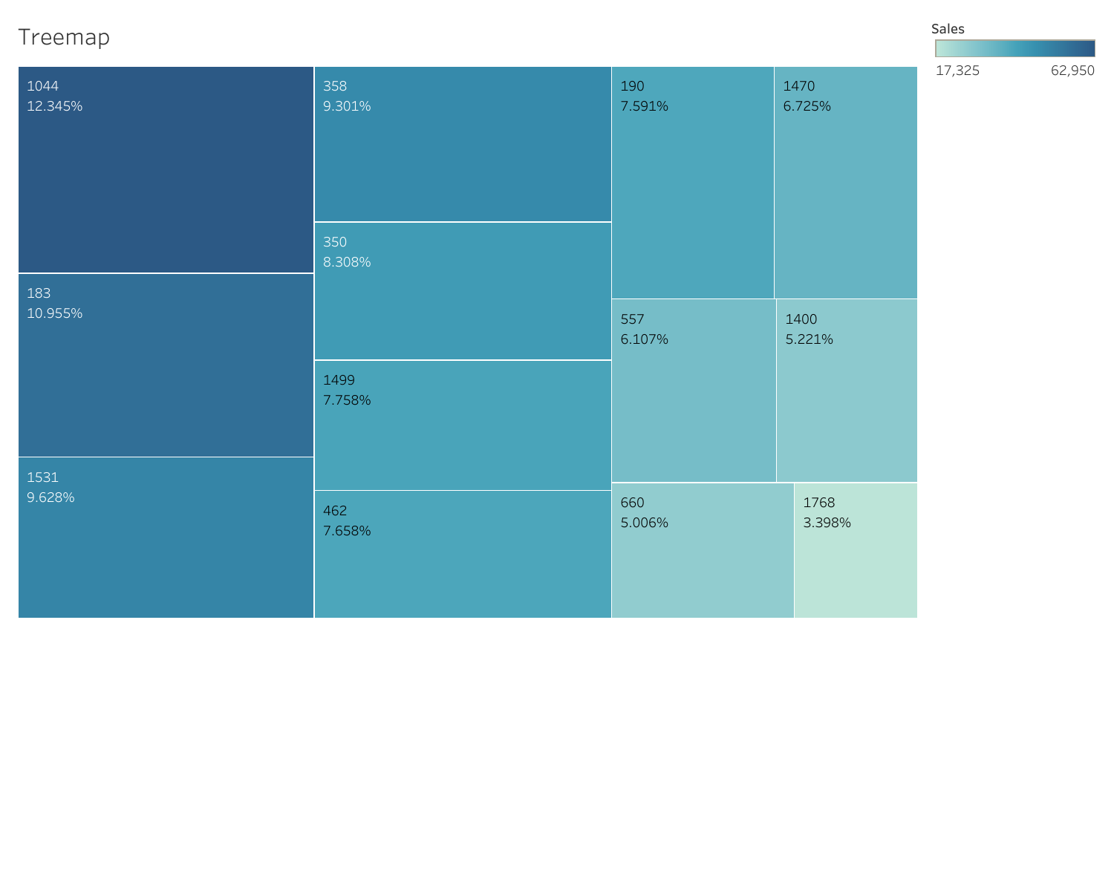
4) Tier Store Level Performance
Parent Store Number
183 Tier 1
190 Tier 1
350 Tier 1
358 Tier 1
462 Tier 1
557 Tier 2
660 Tier 3
1044 Tier 1
1400 Tier 3
1470 Tier 2
1499 Tier 1
1531 Tier 1
1768 Tier 4
dtype: category
Categories (4, object): ['Tier 4'
< 'Tier 3' < 'Tier 2'
< 'Tier 1']
pd.cut()

Slide 14
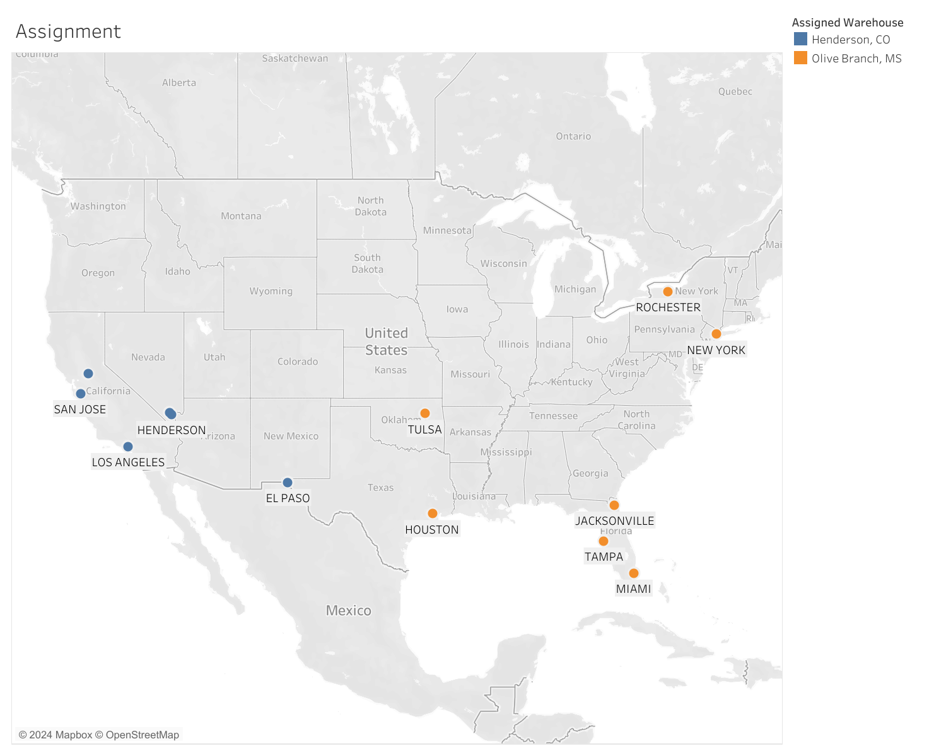

5) Store-Warehouse Selection
OpenCage - get Coordinates of stores
from geopy.distance import geodesic - get Distances from stores to warehouses

Slide 15
Thank You

